Slide 1
Rockridge BART Safe Routes to Transit Project
Community Meeting
Wednesday, September 30, 2015
Rockridge Library
Notes:
Wlad
Welcome
Introduce Monica from Council member Kalb’s office
The Council member couldn’t be here because there is a special Council session on housing tonight.
Council member’s office welcomes feedback about this project, so Monica will be here taking notes to bring back to her office.
Tonight we’re going to present the Rockridge SR2T, but will also give an overview of status of other Caldecott-funded projects.
Rockridge SR2T project – Good news!
Caldecott process resulted in 4 projects in the vicinity of the RR BART station
We leveraged Caldecott funding allocated to those projects, plus contributions from the FBC’s own SA and from BART to win a regional SR2T grant
Coordinating with planned project to resurface College Ave
Introduce Victoria
Familiar because she’s our consultant for the Caldecott process, which is partly paying for the project we’re going to focus on tonight
Although we’re here primarily to present and get your comments and questions on the Rockridge SR2T project, we understand that many of you are also interested in projects further down the list
Victoria will provide a brief update on the status of the other Caldecott-funded projects, but we are planning a separate meeting WHEN??? for a full report.
Victoria
1 2-sided handout
Sign-in sheet
Comment cards (more on that in a moment)
Refreshments

Slide 2
Process to date
2008 Oakland settlement with Caltrans
2010 Long public process resulted in new list
Public meeting
250 comments
2011-13 Final project list
Development of highest priority projects
Update and course correction, as needed
2014-15 Final design & bids for top projects
Revised project list
Notes:
Victoria
Many of you were involved with identifying the original list of projects, about five years ago, and could come up here and give this part of the presentation.
Some of you have helped us design many of these projects since then, by coming to meetings like this one.
For the rest of you, a very brief history…
$8m settlement from Caltrans to C of Oakland over a lawsuit over the adequacy of the environmental document for the fourth bore of the Caldecott Tunnel project.
Money can be spent on projects that improve walking, cycling and noise in the SR24 corridor between the Caldecott Tunnel and I-580.
2010
First got to know each other through long walking tours and meetings to ID projects that would be funded w/settlement
2011-13
We worked with you to refine the draft list into a final project list, which included 4 projects in the vicinity of the Rockridge BART station, the main focus of tonight’s mtg
The list exceeded $8 million, in case construction costs ended up being less than estimated and/or projects fell off the list due to finding alternate funding sources or infeasibility.
Next, City began developing the highest priority projects on the list (i.e., those closest to the impact of the fourth bore – nearest the tunnel)
2014-15
Since then, have been finalizing the designs of these top projects and bidding them for construction.

Slide 3
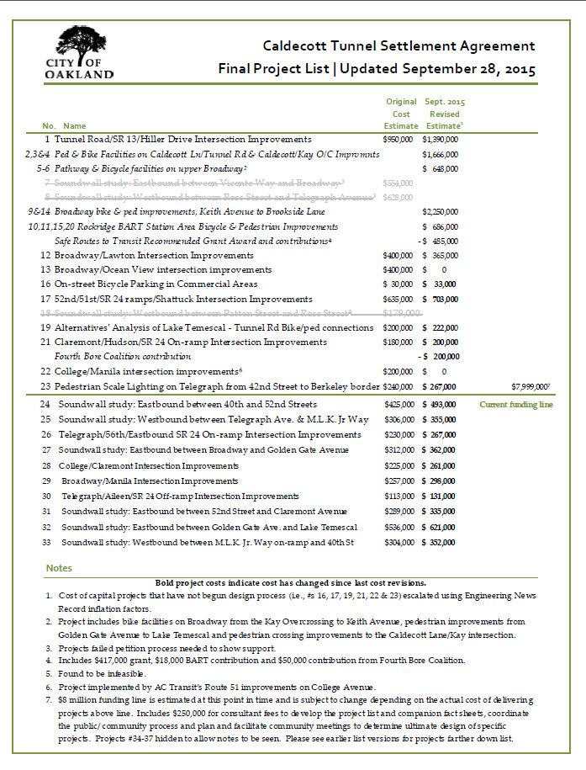
Notes:
This list is on one side of the handout.
Current funding list & funding line
List projects above the line
I understand that each of these projects is incredibly important to at least one of you.
Unfortunately, if we are going to be able to hear all of your comments and suggestions for the Rockridge SR2T project, we’re going to have to put off discussing this list in detail until MONTH????
Same list as some of you last saw with projects that are being designed together combined & in italics
Most recent cost estimates are in bold in the 2nd column.
Projects #34-37 hidden to allow notes to be seen.
As has always been the case, the funding line may move up or down further, depending on actual construction costs, if alternative funding sources are found, and whether any projects end up not being pursued.

Slide 4
Caldecott project tracking
Notes:
This matrix on back of project list.
For each of the six projects that are currently in final design and/or construction stage, matrix lists:
If the project has been discussed with the public and therefore if there is a conceptual design (the fifth row pertains to the four individual Caldecott-funded projects that have been combined with other improvements to form the project we’re talking about tonight).
What % design stage it’s in now (35, 65 or 100%)
If the BPAC has reviewed the project
Where needed, if a Caltrans encr permit app has been submitted – not RR bc no CT r/w
If the construction contract has been advertised, if CC has awarded the contract and
What you’ve all been waiting for, when construction is estimated to begin.
The rest of this evening is going to focus on the RR SR2T project.
If you have questions about the overall Caldecott process, please put them on a comment card. If there’s time after all of the questions/comments about the SR2T project have been addressed, then we’ll cover those too; if not, I’m happy to stay after the meeting is over to talk about the overall process. Again, we’re planning a fuller update WHEN.

Slide 5
Project background
2007 Bicycle Master Plan
2008 Caldecott process
SR2T grant
Meetings with:
AC Transit
College Avenue merchants
Community
Notes:
And now, the presentation you’ve been waiting for, the RR SR2T project.
If questions or comments come to mind, please write them on a speaker card and pass them up to the front. At the conclusion of the presentation, staff and their consultants will respond to these questions.
If these responses, or questions others ask, prompt more questions, just fill out another card. We’ll stay until there are no more questions.
We’ve been using this process for years
It may seem awkward, but we’ve found that it actually allows more time for alternative points of view to be voiced and considered rather than less as some perceive.
City staff & consultant team here to respond to your questions are:
Wlad, Transportation Services Division Manager of Oakland’s public works agency
Ade Oluwasogo, supervising transportation engineer for this and all of the Caldecott-projects
Si Lau, transportation engineer and PM of this project
Jason Patton, Bicycle & Pedestrian Program Manager
Jennifer Harmon of Diablo Engineering Group, the project designer
Ryan McClain of Fehr & Peers, the project traffic engineer
Oakland Bike Master Plan ID’ed College Ave as one of streets with highest bicyclist collisions.
Plan includes a SR2T policy that calls for implementing bikeway improvements to all BART stations.
Thru Caldecott process, neighborhood asked for improvements at College/Shafter/Keith and College/Miles
As Wlad mentioned, in 2014 City received $472k SR2T grant, which leveraged Caldecott funds, support from FBC & BART and City funds set aside to resurface College Ave
More recently, we met with AC Transit and then with Chris from the Rockridge District Association and the business owners of property on College/Shafter/Keith and College/Miles where the largest changes are envisioned. Tonight, it’s your turn

Slide 6
Project area
Miles Ave
Shafter/Keith Ave

Slide 7
Existing roadway
Frequent pedestrian and bicycle activities
Overcrowded sidewalk corners
2 vehicle lanes (except 1 block)
46’ curb-to-curb wide (mostly)
Notes:
Major arterial
Lots of pedestrians, particularly around the BART station when trains arrive
High rate of cyclists too, and as we’ll get to in a minute, bicycle collisions
2 vehicle lanes (except 1 SB block between Manila and Kales Ave)
ADT (Average Daily Traffic): 18,000 vehicles per day
46’ curb-to-curb wide, with a few short 40’ segments, as we’ll see

Slide 8
Project goals
Improve pedestrian access at the intersections closest to Rockridge BART Station
Provide better bicycle access along corridor
Fill gap in Oakland’s bicycle network
Notes:
Also, Provide additional bicycle parking at the Rockridge BART Station (will be delivered as a separate project)

Slide 9
Project components
Bicycle lanes
College/Shafter/Keith improvements
College/Miles improvements
Notes:
3 components
Add bicycle lane on both side of College Ave where possible
Add bulb-outs at College/Shafter/Keith intersection to improve pedestrian access
Remove free right turn from SB College to WB Miles to provide safer pedestrian access
Reduce the number of traffic lanes from 3 to 2 (1 lane each direction) between Manila and Kales Ave
Add EB bicycle lane on Shafter Ave between Forest St and College Ave

Slide 10
Bicycle lanes
College Ave: Broadway to Alcatraz Avenue
No loss of parking
No loss of travel lanes (except 1 block)
Also on Shafter and Keith

Slide 11
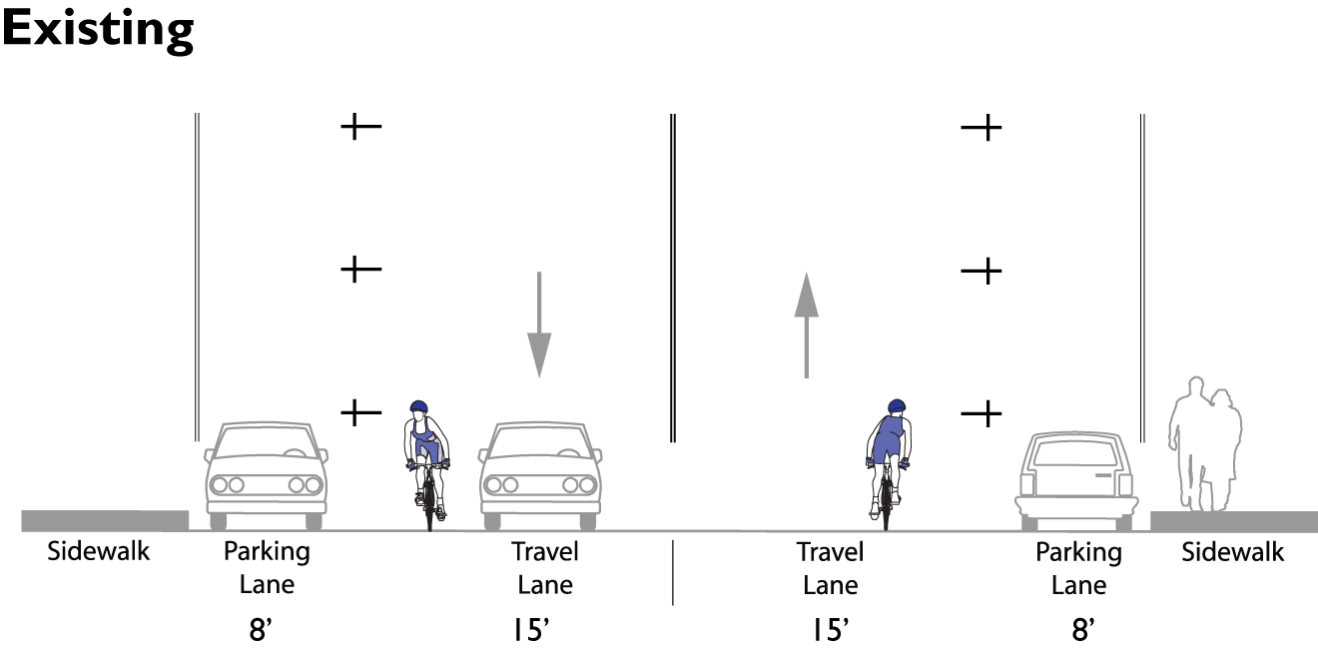
Bicycle lanes | College Avenue
Notes:
All of College Ave is 46’ wide, between Broadway and Claremont. Same width as Shattuck Ave, which has just been repainted using the same configuration proposed here.

Slide 12
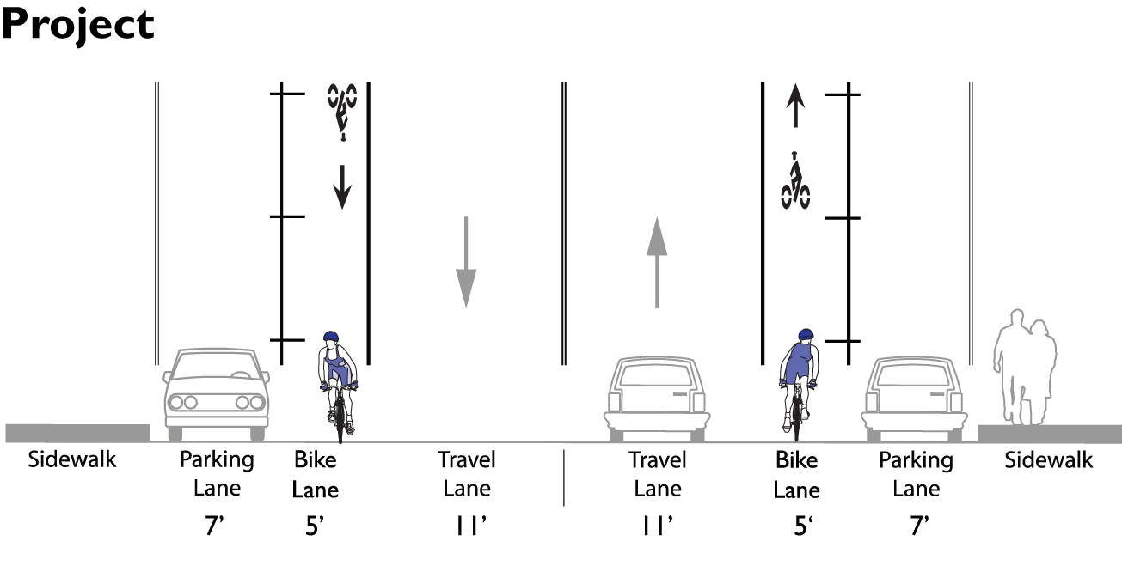
Bicycle lanes | College Avenue
Notes:
On all but the two hills, we propose narrowing the traffic lanes, but giving bicyclists in both directions a lane of their own, as shown.

Slide 13
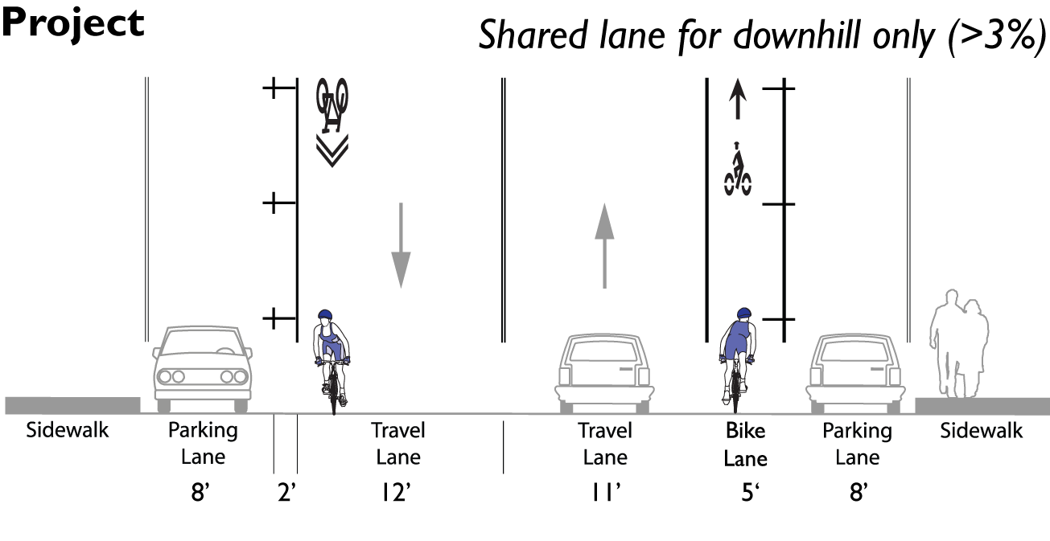
Bicycle lanes | College Avenue
Notes:
On the portions of College Ave with over about 3% slope (Broadway to Bryant and Manila to Taft), where cyclists don’t have trouble keeping up with cars, we’d widen the travel lane in the downhill direction (NB B’way/Bryant and SB Manila/Taft) and have cyclists share the lane with a sharrow.
2 small exceptions with different than 46’ x-sections:
Under the freeway at the BART station is wider, which is why the City has recently striped bike lanes in both directions.
The only portion of College Ave with a smaller cross-section is between Claremont and Alcatraz, where it’s 40’. There, we propose leaving the lanes as is and painting sharrows in the traffic lanes to indicate where cyclists should ride and connect the new bike lanes south of the project with bike lanes on Alcatraz.

Slide 14
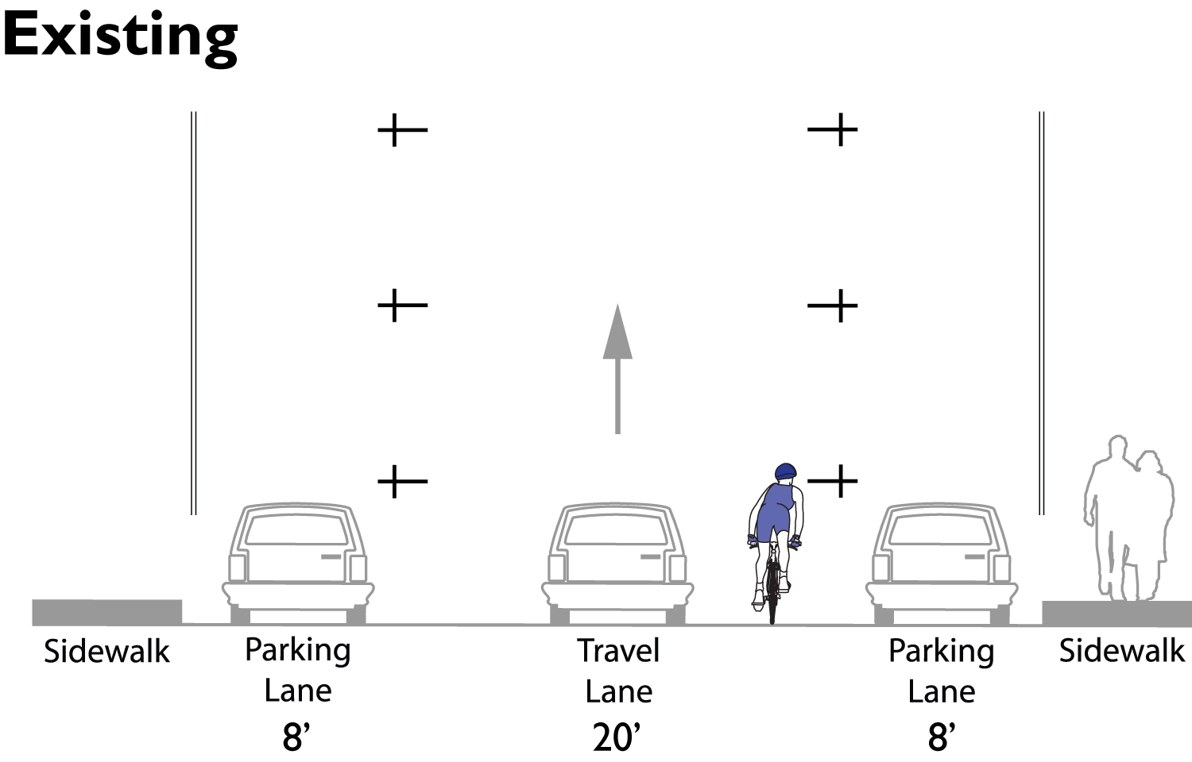
Bicycle lanes | Shafter Avenue
Notes:
On Shafter, between Forest and College, we propose narrowing the exceptionally wide travel lane to add a bike lane and buffer.

Slide 15
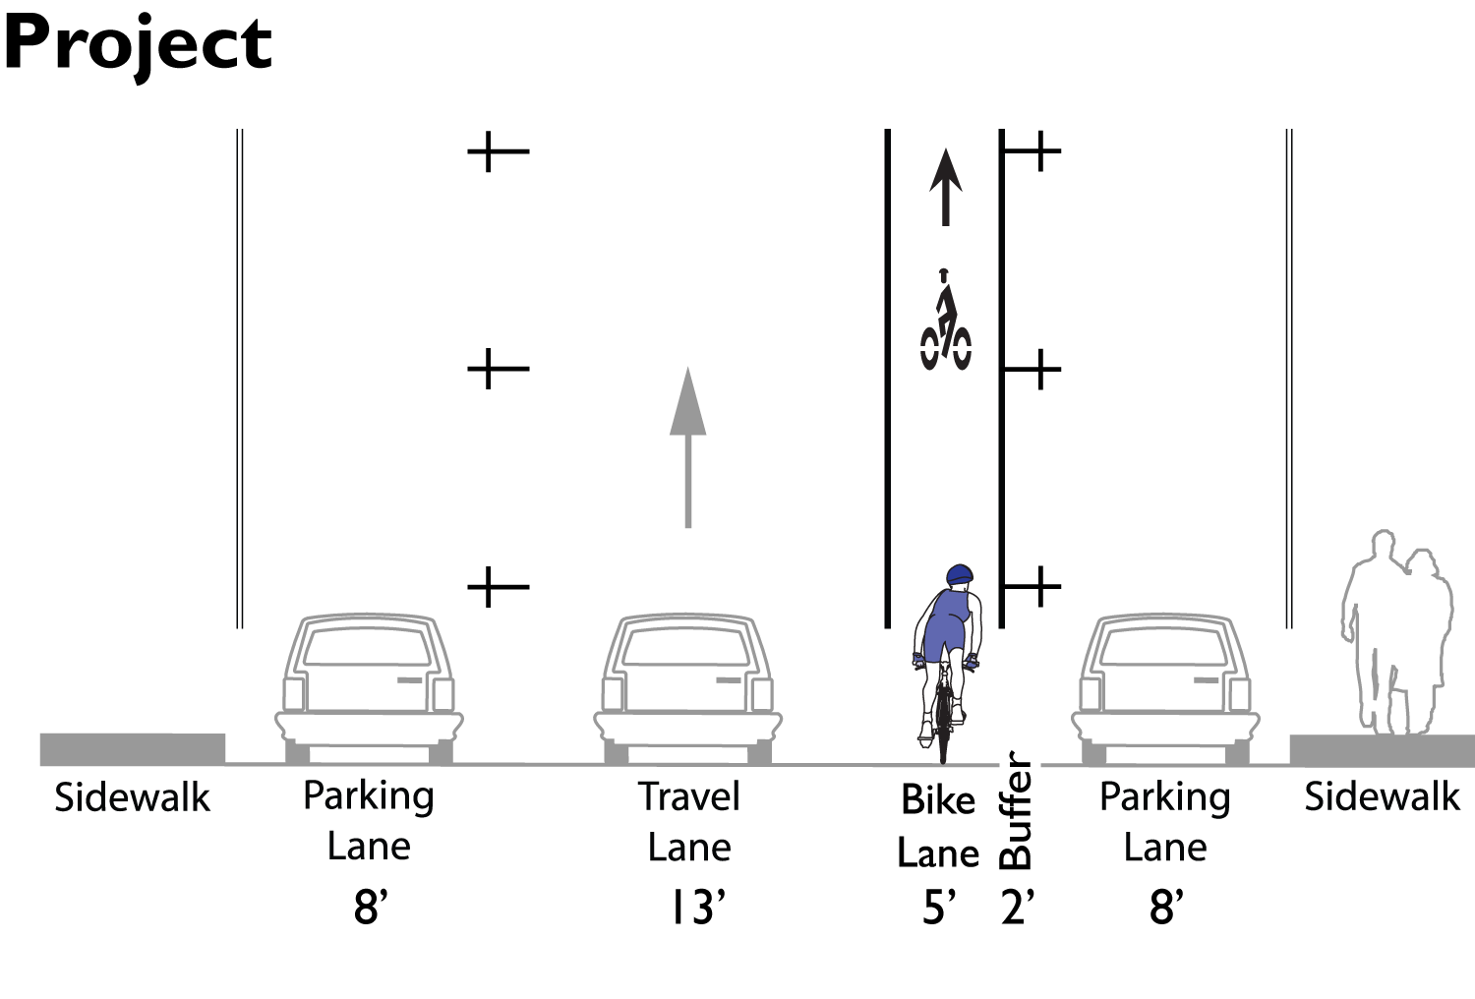
Bicycle lanes | Shafter Avenue
Notes:
On Shafter, between Forest and College, we propose narrowing the exceptionally wide travel lane to add a bike lane and buffer.

Slide 16
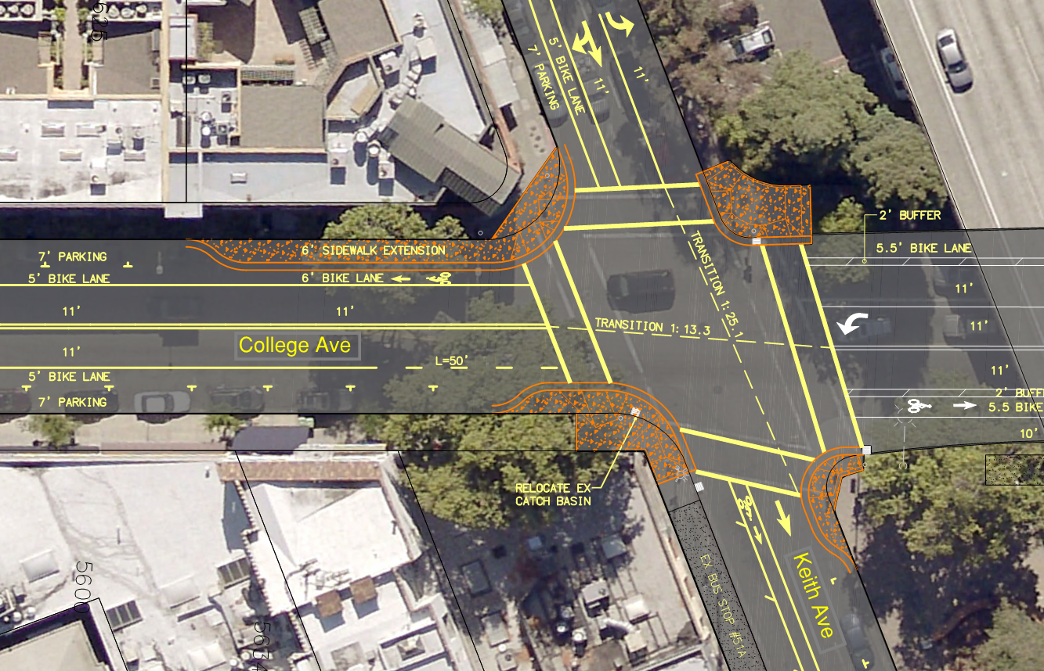
College/Shafter/Keith intersection
Notes:
Using a pointer…
Bulbout on all four corners, largest on SW and SE corners where there are the greatest conflicts between peds waiting to cross and those walking by.
Curb extension on west side of College to increase sidewalk seating opportunities
Pedestrian countdown signal
Improved curb ramps to comply with latest ADA regulations
Shafter: left turn lane & bike lane
Keith: bike lane:

Slide 17
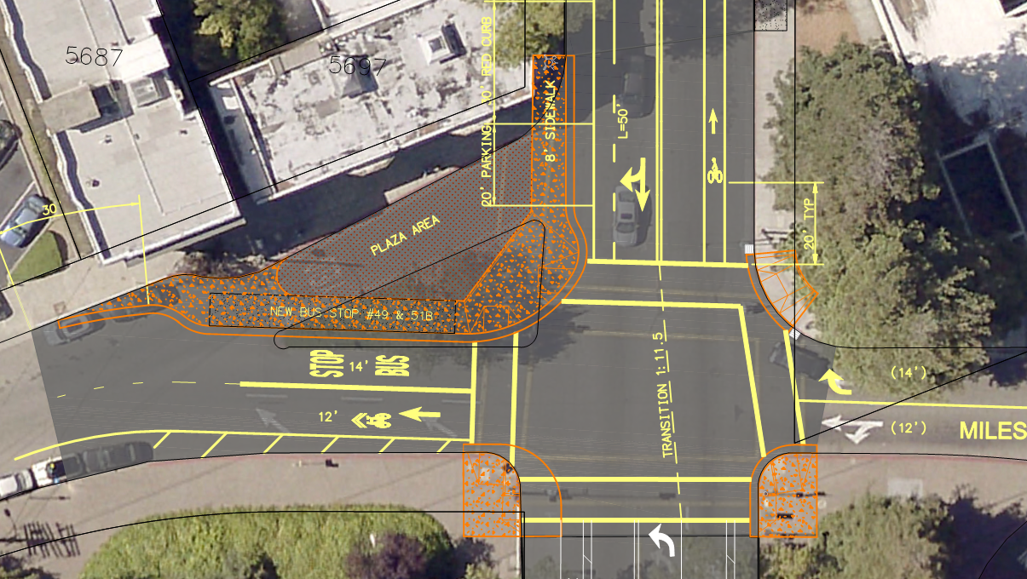
College/Miles improvements
Notes:
Close slip lane to create a pedestrian plaza
Relocate bus stop
Pedestrian countdown signal
ADA curb ramp improvements
Miles on east side of College: right-only lane
Would any of you be interested in working with RCPC and the RDA to help take care of the new plaza that will be created on the northwest corner of College/Miles?

Slide 18
Project timeline
June 2015: Met with AC Transit
Sept 2015: Met with Rockridge merchants
Presented to BPAC
Community meeting
Oct 2015: Comment deadline
Spring 2016: Complete design
Fall 2016: Start construction

Slide 19
Rockridge BART Safe Routes to Transit Community Meeting
Additional Comments by 5:00 pm Friday 10/16/15
Victoria Eisen | Eisen|Letunic (City consultant)
victoria@eisenletunic.com
510-525-0220

